Slide 1

COURSE: B.Sc. (PROGRAMME) IN ECONOMICS
PAPER NAME – MACROECONOMICS-I
TOPIC-KEYNESIAN CONSUMPTION FUNCTION AND SAVINGS FUNCTION
YEAR- FIRST SEMESTER- 2 SESSION- 2020-2021
DATE OF LECTURE : 15/06/2021
PREPARED BY
DR. KAMALIKA CHAKRABORTY
ASSISTANT PROFESSOR (DEPARTMENT OF ECONOMICS)
KHATRA ADIBASI MAHAVIDYALAYA, BANKURA,WEST BENGAL

Slide 2
Definition of Keynesian Consumption Function:
Keynesian consumption function, is an economic formula that shows the functional relationship between total consumption and gross national income.
Characteristics of Keynesian Consumption Function:
Aggregate real consumption expenditure is a stable function of real income.
(2) The marginal propensity to consume (MPC) or the slope of the consumption function defined as dc/dY must lie between zero and one i.e. 0 < MPC < 1.
(3) The average propensity to consume (APC) or the proportion of income spent on consumption defined as C/Y decreases as income increases. When the average propensity to consume (APC) falls, the marginal propensity to consume (MPC) must be lower than the APC.

Slide 3
Characteristics of Keynesian Consumption Function (contd.):
(4) The marginal propensity to consume (MPC) itself probably decreases or remains constant as income increases.
The consumption function formula is C=a+bY where: C is the total consumption. a is the basic consumption. b is MPC. Y is income.

Slide 4
Definition of Keynesian Savings Function:
Keynesian savings function, is an economic formula that shows the functional relationship between total savings and gross national income.
Characteristics of Keynesian Savings Function:
1. Saving is a stable function of income.
2 .Saving varies directly with income.
3. The rate of increase in saving is less than the rate of increase in income.

Slide 5
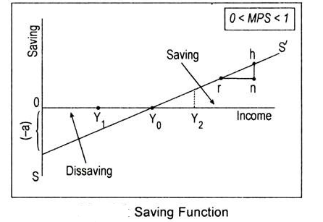

Keynesian Savings Function
S = Y – C = Y – (a + bY) [... C = a + bY]
or S = – a + (1 – b)Y [0< (l-b) < l]
Savings function has a negative intercept indicated by –a
and positive intercept denoted by 1-b.
(1-b) is called the Marginal Propensity to Save or MPS.
MPS is the change in savings due to change in income. MPS = ∆S /∆Y
The value of MPS is always less than one.
APS is the proportion of income devoted to savings. It is obtained by dividing total saving by total income, i.e.,

Slide 6
THANK YOU

